Slide 1



Slide 2

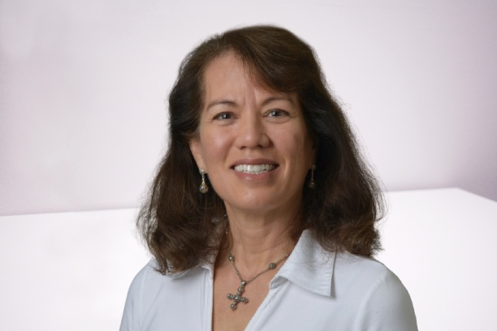
In Loving Memory
MARTHA ANN WHITAKER
May 23, -1947 To December 2, 2021

Slide 3
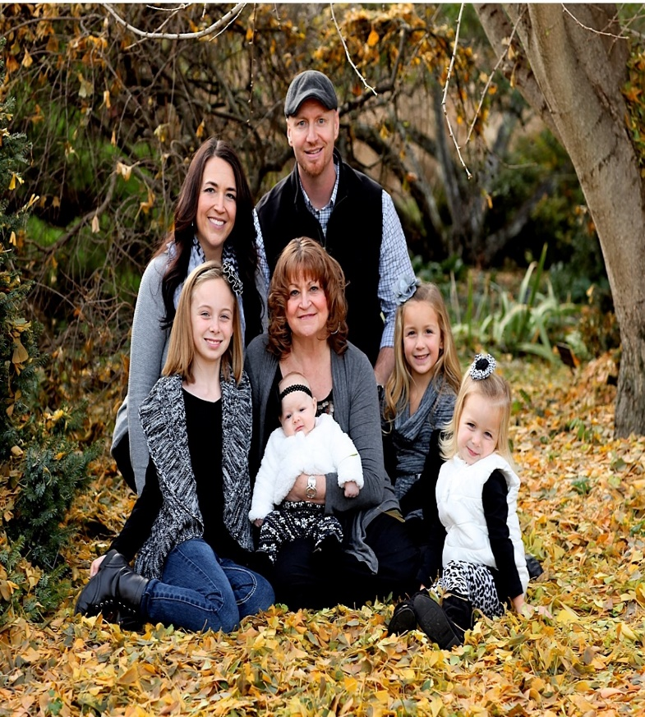

Remembering…… Martha Ann Whitaker
"Today, we come together to honor and reflect on the life of Martha Ann Whitaker. This is a time for remembrance, as we celebrate her life, the love she gave, and the lasting impact she had on those around her. Martha was a woman of warmth, kindness, and strength, whose presence brightened the lives of everyone she met. As we remember her, let us reflect on the beautiful moments we shared with her and the legacy she leaves in our hearts. Though she is no longer with us, Martha's spirit remains alive in our memories, and she will never be forgotten."

Slide 4

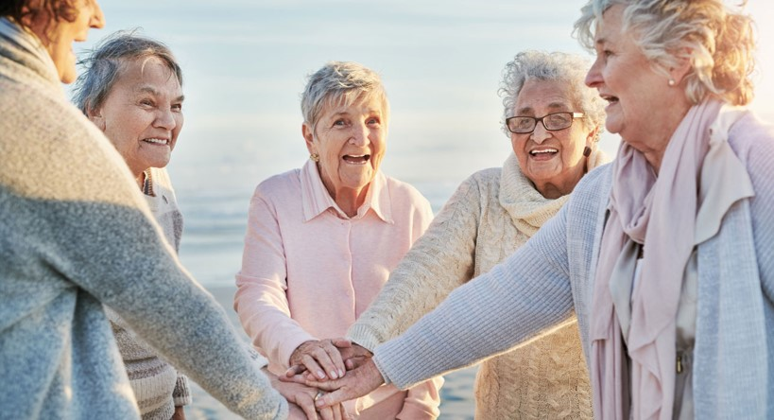


Forever in our hearts
MARTHA ANN WHITAKER

Slide 5
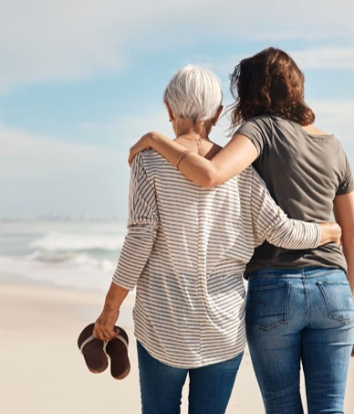

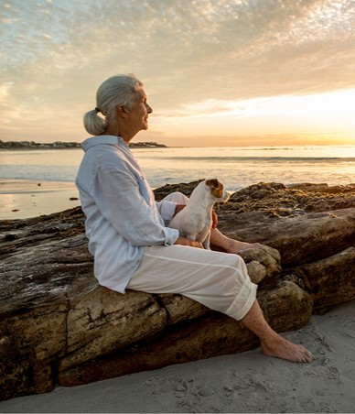
A sweet memory with Martha Ann Whitaker

Slide 6
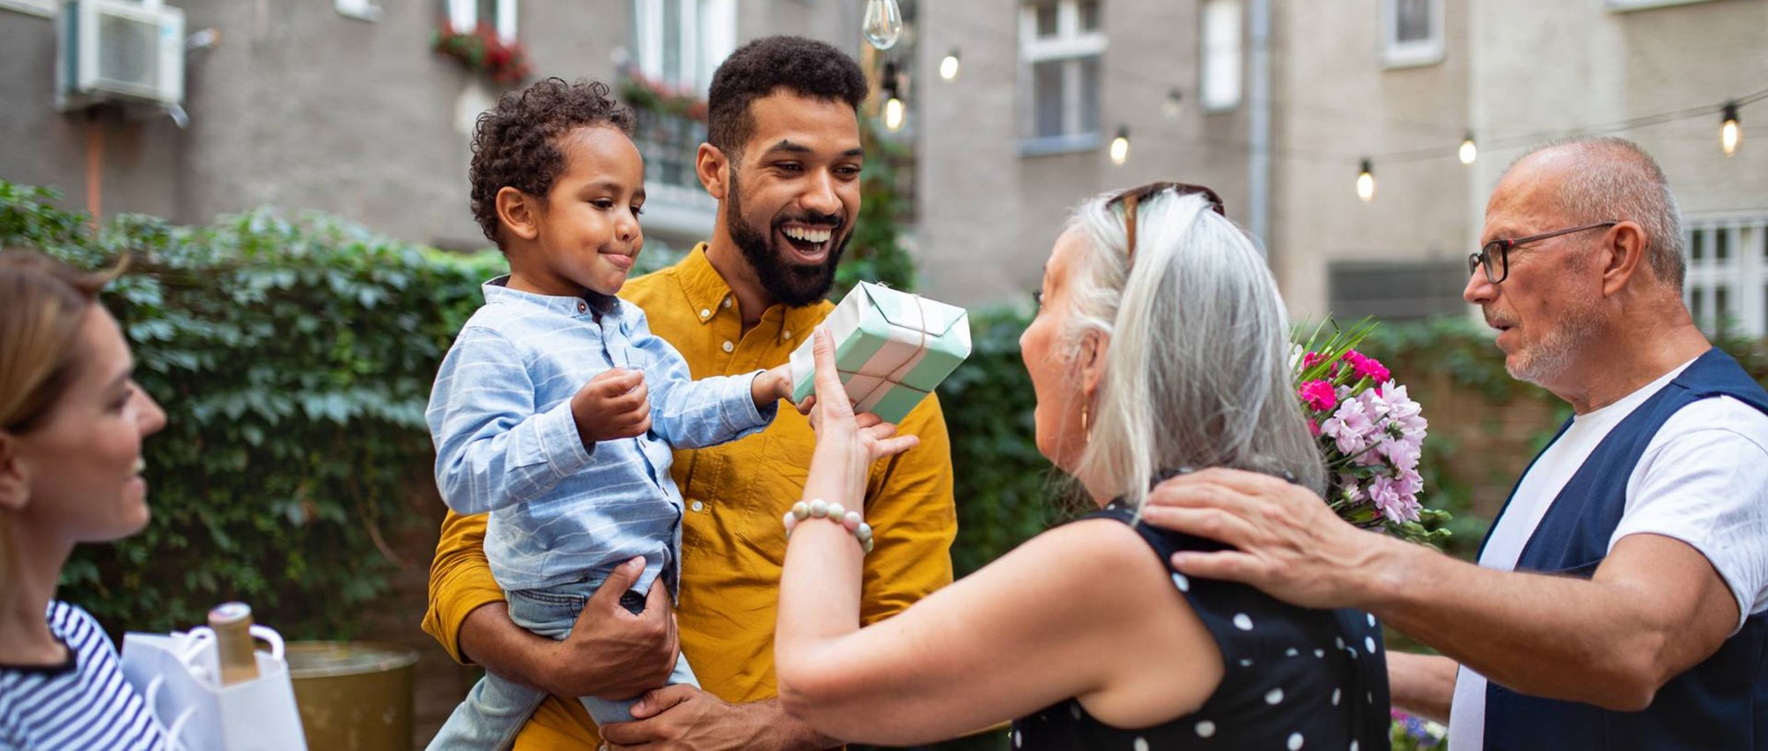

Wishing you strength and peace as you honor the memory of Martha Ann Whitaker.

Slide 7



